Slide 1


MOBILE HEALTH • PROJECT REPORT
HeartHealth — Mobile Cardiovascular
Health Management
CSE 430 — Project Mobile Report
Nguyễn Hoàng Giang • 2131200071
Supervisors : Trần Văn Tài & Nguyễn Hoàng Lý
Eastern International University — August 2026

Slide 2
02 HEARTHEALTH
The Global CVD Crisis
EARLY DETECTION MATTERS
19.8M
32%
Daily monitoring surfaces cardiovascular risk before symptoms escalate — enabling timely intervention and better outcomes.
deaths worldwide in 2022
of all global deaths
Source: WHO Global Health Estimates, 2022
HeartHealth raises health awareness and supports self-monitoring.
It does not replace professional medical diagnosis.
85%
3 in 4
caused by heart attacks & strokes
CVD deaths in low- & middle-income countries
CSE 430 • HEARTHEALTH • 02

Slide 3


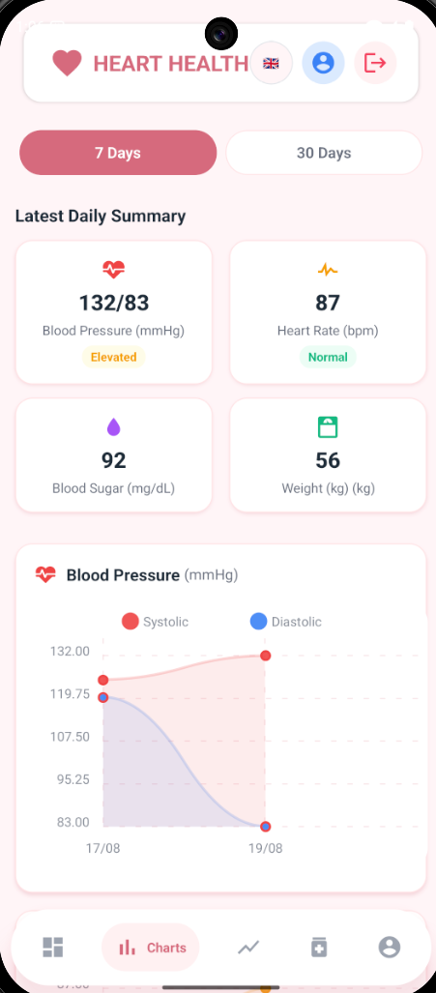










03
HEARTHEALTH
My Mobile
App Solution
HeartHealth is the mobile app I designed
to solve everyday cardiovascular care challenges.
Daily vitals
4-step
screening
Trend
tracking
Medication & appointments
Do
Designed and developed by
Nguyễn Hoàng Giang
CSE 430 • HEARTHEALTH • 03

Slide 4

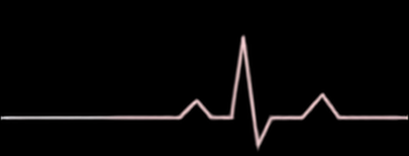























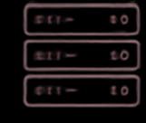


04
HEARTHEALTH
Technology Stack — Backend
JAVA 17
JPA /HIBERNATE
GMAIL SMTP
Modern runtime
Persistence layer
OTP authentication
SPRING BOOT 4.1
MYSQL 8.0+
LOMBOK + MAVEN
REST application core
7 core tables
Lean, reproducible builds
CSE 430 • HEARTHEALTH • 04

Slide 5


























05
HEARTHEALTH
Technology Stack — Frontend
01
02
03
React Native 0.74+
React-navigation
React-native‑chart‑kit
04
05
06
Community slider
Axios HTTP client
Context API • VN / EN
A fast, native‑feeling interface built around clarity, trends, and bilingual access.
CSE 430 • HEARTHEALTH • 05

Slide 6

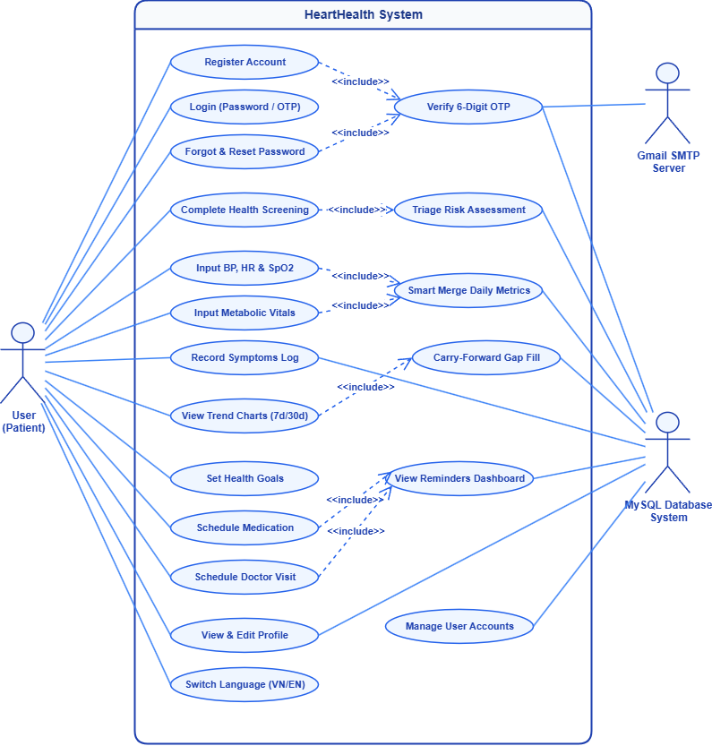




06
HEARTHEALTH
Use Case Summary
1. Key Actors
Patient (User): Main actor for vitals tracking & scheduling
Gmail SMTP: Delivers 6-digit OTP verification emails
MySQL Database: Manages central health data persistence
Admin: Handles system user account management
2. Core Functions & Logic
Auth & Security: OTP verification for Register & Password Reset
Screening & Triage: 4-step wizard → 4 risk levels (Red / Orange / Yellow / Green)
Vitals & Analytics: Tracking + Smart Merge & Carry-Forward trend charts
Scheduling: Daily medication alarms & doctor appointment alerts
Settings: Profile management & instant VN/EN language toggle
CSE 430 • HEARTHEALTH • 06

Slide 7
07
HEARTHEALTH
Activity Flows
01
02
03
04
AUTHENTICATION
Authentication
Register / Reset → Gmail OTP → Server Verify
HEALTH SCREENING
Health Screening
3-Step Survey → Clinical Threshold → 4 Risk Tiers
Daily Metrics
DAILY METRICS
Slider Input → Smart Merge → Trend Charts
Scheduling
SCHEDULING
Medication & Doctor → DB Save → Live Dashboard
CSE 430 • HEARTHEALTH • 07

Slide 8
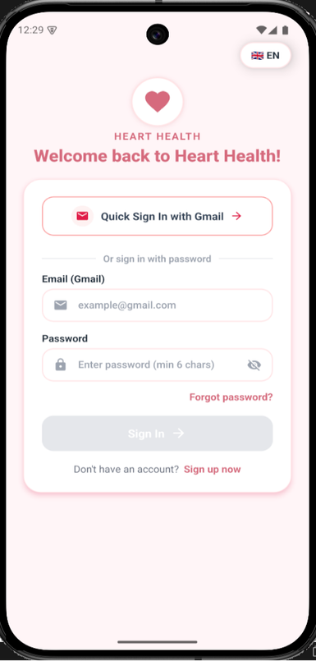
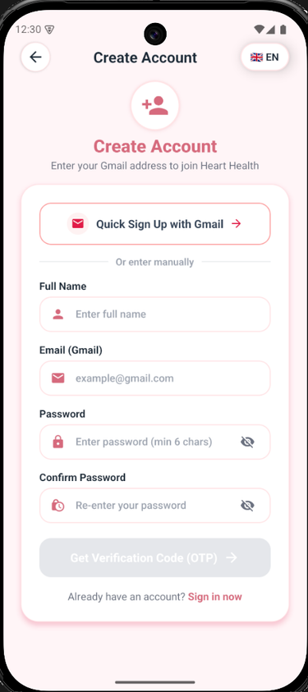
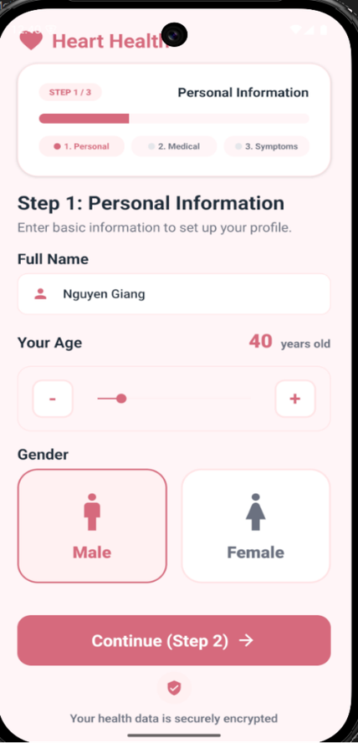
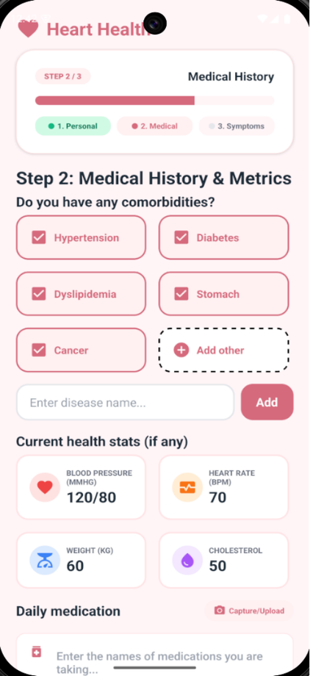
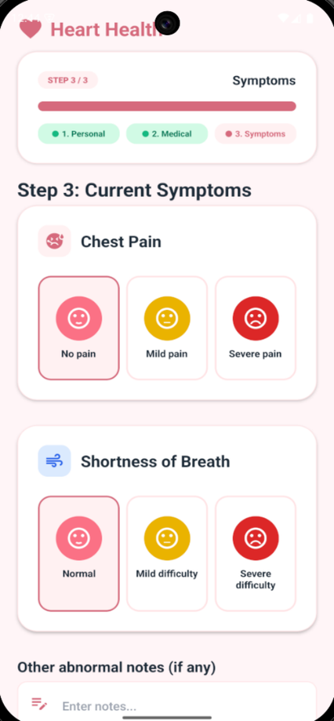
08
HEARTHEALTH
Application Results — Authentication & Screening
CSE 430 • HEARTHEALTH • 08

Slide 9
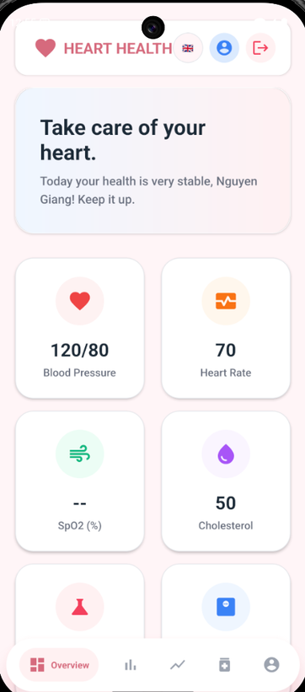
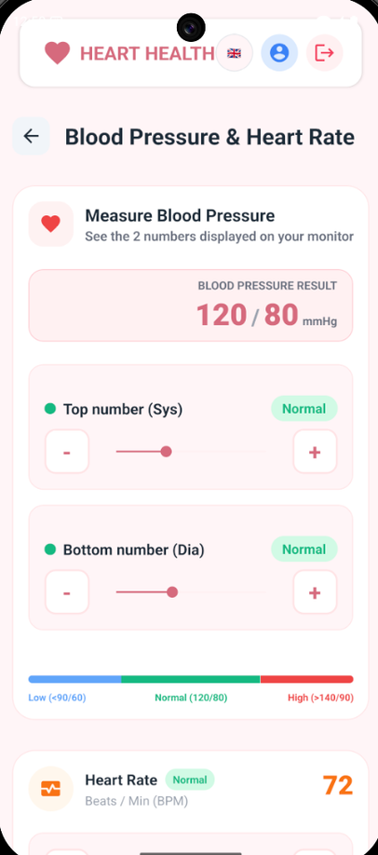
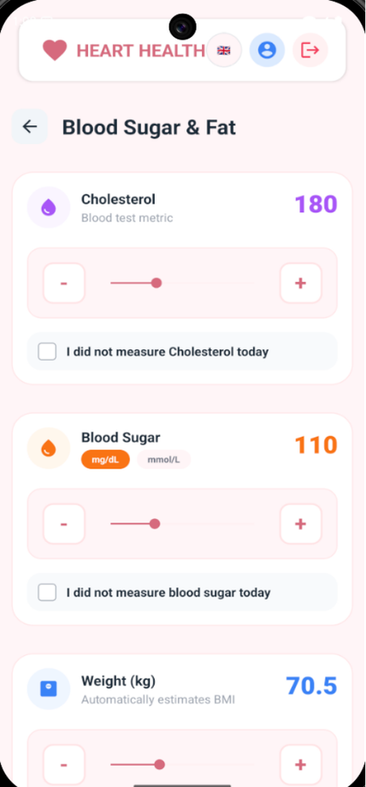
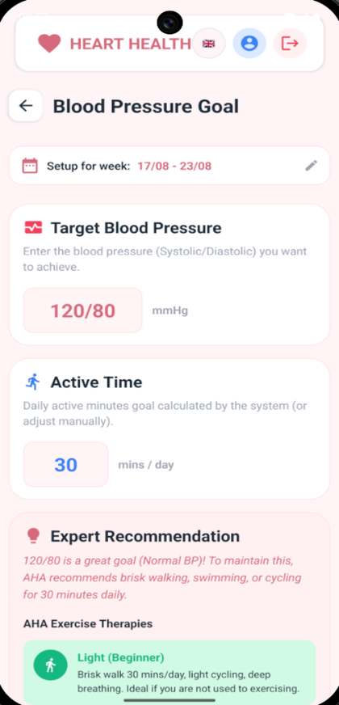
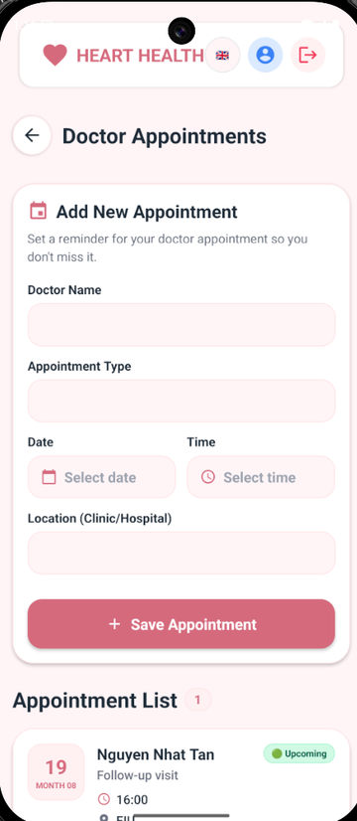
09
HEARTHEALTH
Application Results — Dashboard, Metrics & Scheduling
CSE 430 • HEARTHEALTH • 09

Slide 10
10
HEARTHEALTH
Conclusion & Future Works
BUILT TODAY
NEXT
Easy daily tracking of vital signs
Real-time 4-level risk alerts
Visual Progress charts for peace of mind
Smart medication & doctor alarms
Friendly for Vietnamese & English users
Wearable Device Sync — Bluetooth connection with BP cuffs & oximeters
Family & Caregiver Portal — Remote patient monitoring for relatives & doctors
Offline Storage & Sync — Record vitals offline with automatic background sync
Exportable PDF Summaries — Generate shareable health logs for cardiologist visits
CSE 430 • HEARTHEALTH • 10

Slide 11
Your heart deserves
the best care —
anytime, anywhere.
THANK YOU / ANY QUESTIONS?
Eastern International University — August 2026

